Slide 1

UCPI Services, Inc.
Universal Common Parcel Indexing
UCPI STATE SUBSCRIPTIONS
Fifty State Universal Common Parcel Indexing Standard Adoption Proposal to Create and Maintain Seamless, Normalized, Real‑time Current Statewide Parcel Maps, Resolving Long‑standing Fragmentation in U.S. Land Parcel Data as called for in OGC OPN SWG Charter.
[GOOGLE OGC OPN SWG Charter for Download].

Slide 2
UCPI Services, Inc.
Universal Common Parcel Indexing
UCPI COMPLEMENTARY STATE SUBSCRIPTION
Presentation Outline
          SITUATION
          Problem
          Solution
          How it works
          Subscription terms

Slide 3
SITUATION
STATEWIDE PARCEL MAP CREATION/UPDATING
Thanks to Thomas Jefferson wanting as government as possible local as possible, [a buggy-ride out and back before sunset], property assessment in the US was allocated to Counties.
UPSIDE. You can argue your assessment with an Assessor who just might be a close neighbor.
DOWNSIDE. The American Cadaster is over 3000 counties using hundreds of disjointed, ever-evolving configurations and updating processes, actually a good thing since many of these adjustments improve response to ever changing public interests.
Open Geospatial Consortium OPN Standards Working Group Charter calls for …
  “The overall intent the proposed OPN Standard is to expedite development of nationwide OPN Repositories, one for every nation, followed by perpetually keeping these OPN Repositories current...”

Slide 4
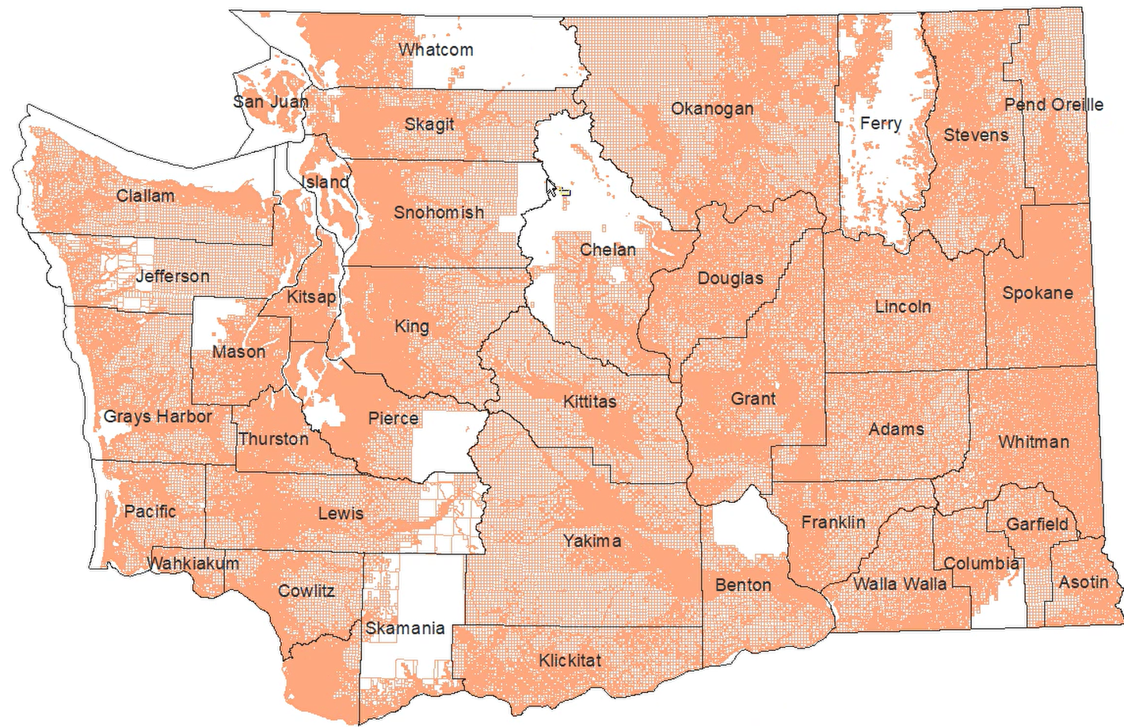
SITUATION
16 US States Already Publish a
Seamless Statewide Parcel Maps.
AR CT DE IN
HI MA ME MT
NC NE ND NH
VA WA WV WY
DOWNSIDE.
- Only two Update Daily; Others
Monthly, Quarterly or Annual.
- ALL are Stand-Alone, Proprietary,
Career- Risking Implementations.
8 Other States Offer Download Portals for 1-OFF Updates.
FL MD IA NE
RI UT TX MN
DOWNSIDE.
- All facing High Cost of 1-off Dev.
- Other 26 States, not Even Started.
SOURCE: Washington State Spatial Data Division
https://geo.wa.gov/maps/current-parcels

Slide 5
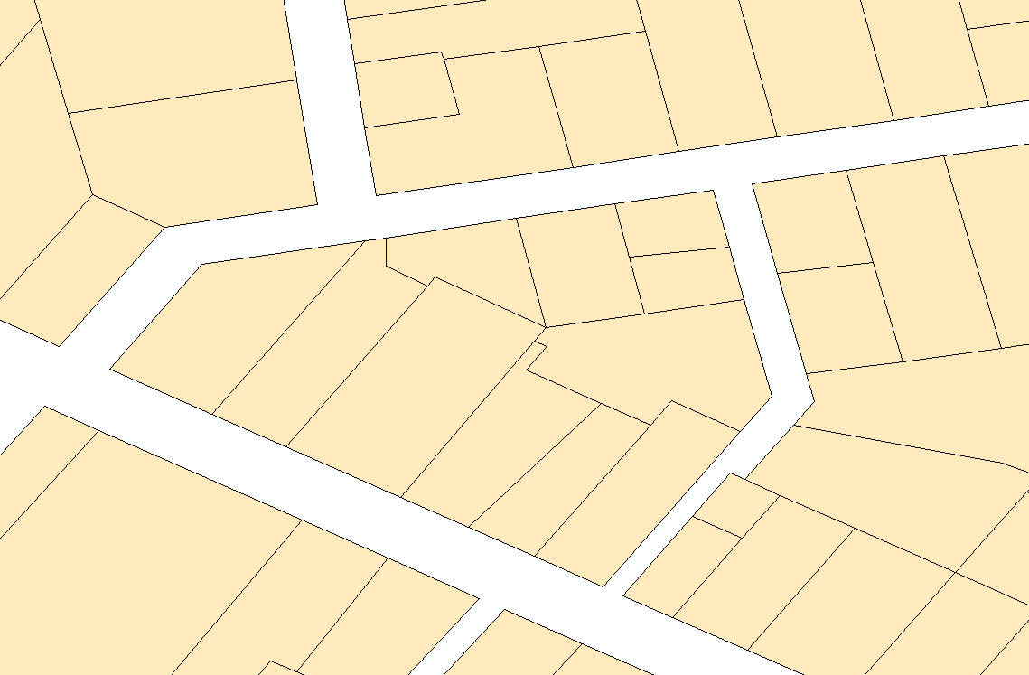

No common parcel index in the U.S.
PROBLEM
No Common
Indexing
HARD TO LINK RECORDS TO MAP
In many developed countries (past kingdoms or colonies), there is one national system that records land and property information. A boundary change anywhere is reported everywhere in the country at the same time.
In the US, property records are handled locally. Upside, easier to challenge or correct your assessments. Downside, changes oft reported only locally, not even across County Lines.
- In addition, all national property record services in the U.S. are offered only by private companies. Lot splits, joins and adjustments are reported when each company decides to do it causing the same change being reported many different times—depending your service.
?
?
?
?
?
Nongraphic
Record
No Common Indexing
HARD TO COMBINE DATABASES
Data HUB No NPNs
Cannot Be Joined
PROPRIETARY Index₁ Attributes₁
PROPRIETARY Index₂ Attributes₂
PROPRIETARY Index₃ Attributes₃
PROPRIETARY Index₄ Attributes₄
APN₁ Attributes₁ OPN₁
APN₂ Attributes₂ OPN₂
APN₃ Attributes₃ OPN₃
APN₄ Attributes₄ OPN₄
NO JOIN
No Common Indexing

Slide 6
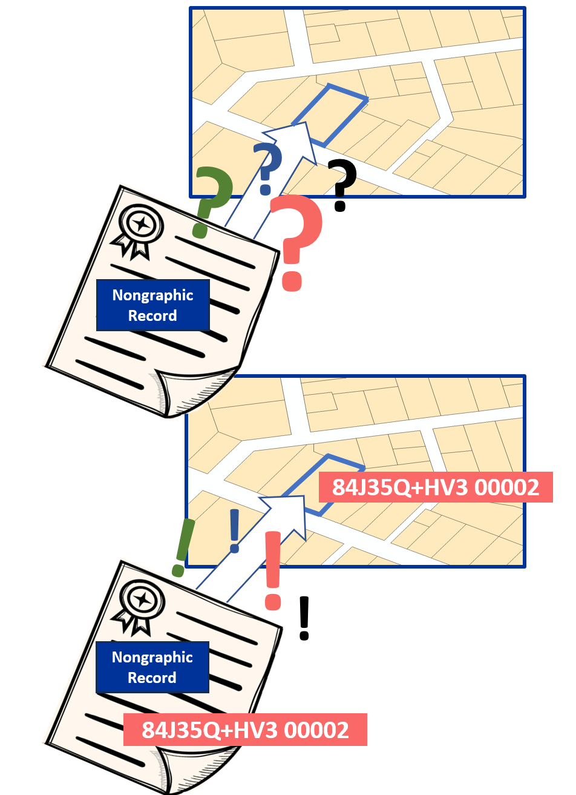
SOLUTION
Persistent
Nonproprietary
Open Parcel Numbers [OPN]
EASY TO LINK RECORDS TO MAP
!
Open Parcel Numbers is the subject of the
OGC OPN SWG.
- UCPI Assigns OPNs to both Parcel Polygons and Records
The UCPI functions as an Open Platform Service, available to ALL users at the same time with industry participation minimizing cost.
!
PLUS CODE
PID [Property Record ID]
!
!
Nongraphic
Record
EASILY COMBINED DATABASES
HUB w. NPNs
Database Easily Joined with Hub
Attributes₁ OPN₁
Attributes₂ OPN₂
Attributes₃ OPN₃
Attributes₄ OPN₄
OPN₁ Attributes₁
OPN₂ Attributes₁
OPN₃ Attributes₁
PN₄ Attributes₁
APN₁ Attributes₁
APN₂ Attributes₂
APN₃ Attributes₃
APN₄ Attributes₄
Point-and- Shoot
JOIN

Slide 7
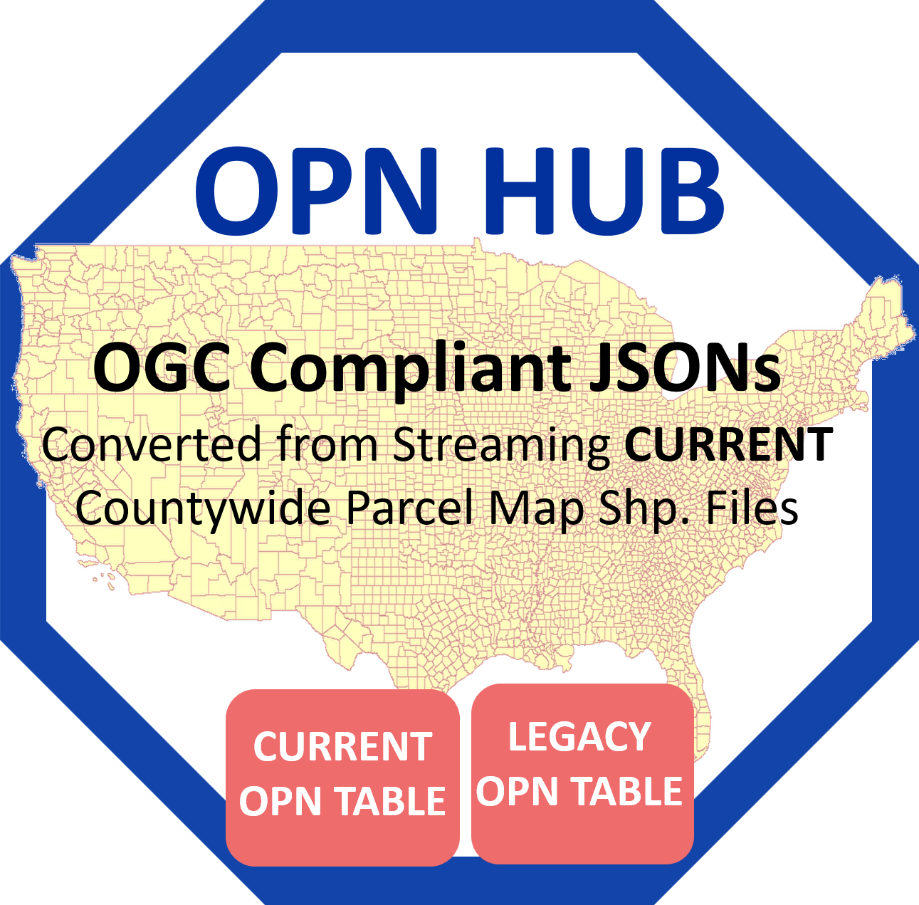
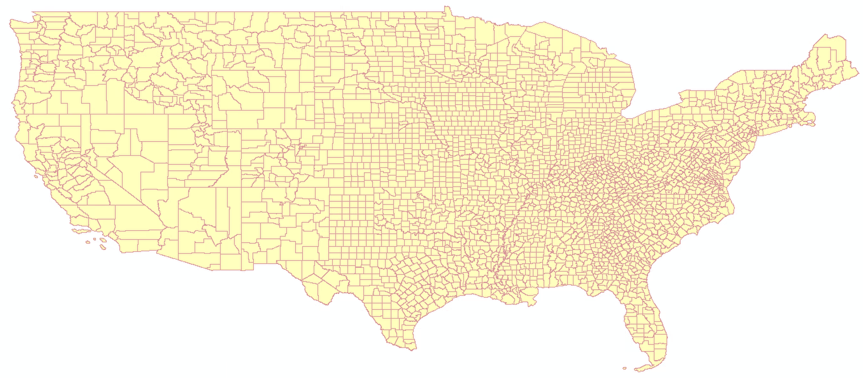
HOW IT WORKS
UCPI
KEY ELEMENT
OPN HUB
OPN HUB is a compilation of JSONs of every Parcel boundary in US [World, as called for in the OGC OPN SWG Charter], each assigned an Open Parcel Number. OPN Fields include OPN, APN, OWNER, CHANGE DATE.
As local changes to County Parcel Map boundaries update the OPN HUB, due to lot line changes, Plus Codes no longer the centroid of any CURRENT parcel are archived in a LEGACY OPN TABLE.
Any Lat/Long Point-in-Parcel value assigned to a data record sent the OPN HUB returns the OPN assigned to the GeoJSON parcel boundary in which it lands. Think of UCPI as many basket balls going through the same hoop, each a different way, but all leaving with the ID number assigned to that hoop.
OGC Compliant JSONs
Converted from Streaming CURRENT Countywide Parcel Map Shp. Files
CURRENT
NPN TABLE
LEGACY
NPN TABLE
LEGACY
OPN TABLE
CURRENT
OPN TABLE

Slide 8
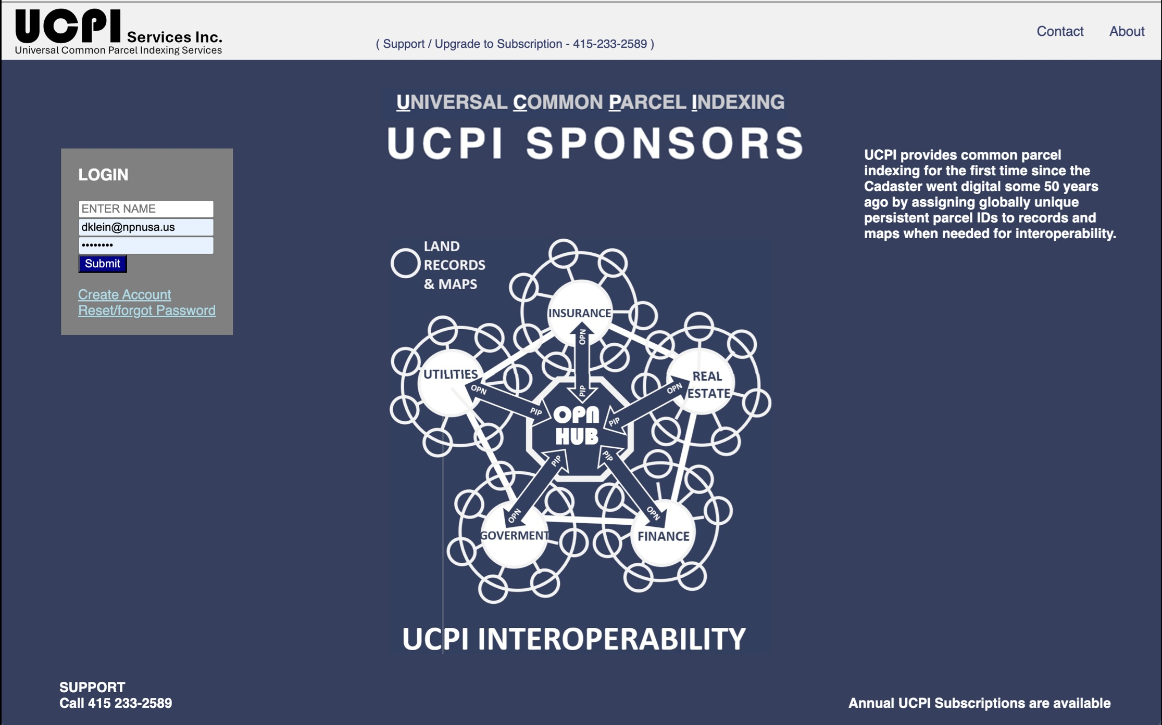
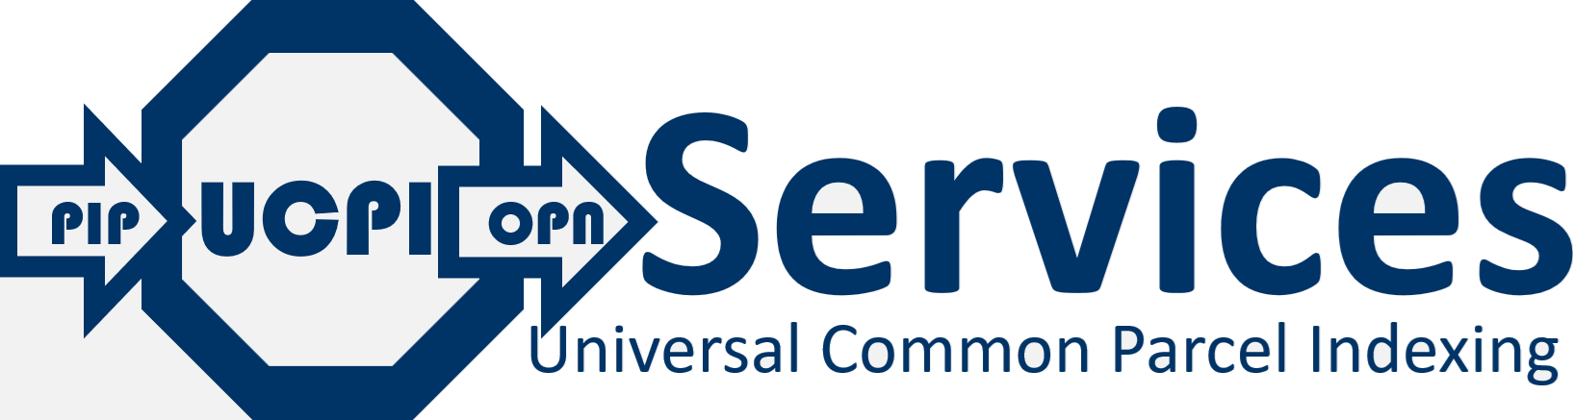



WHAT IT DOES
STATE UCPI
SPONSOR
LOGON SCREEN
UCPI User Interface

Slide 9
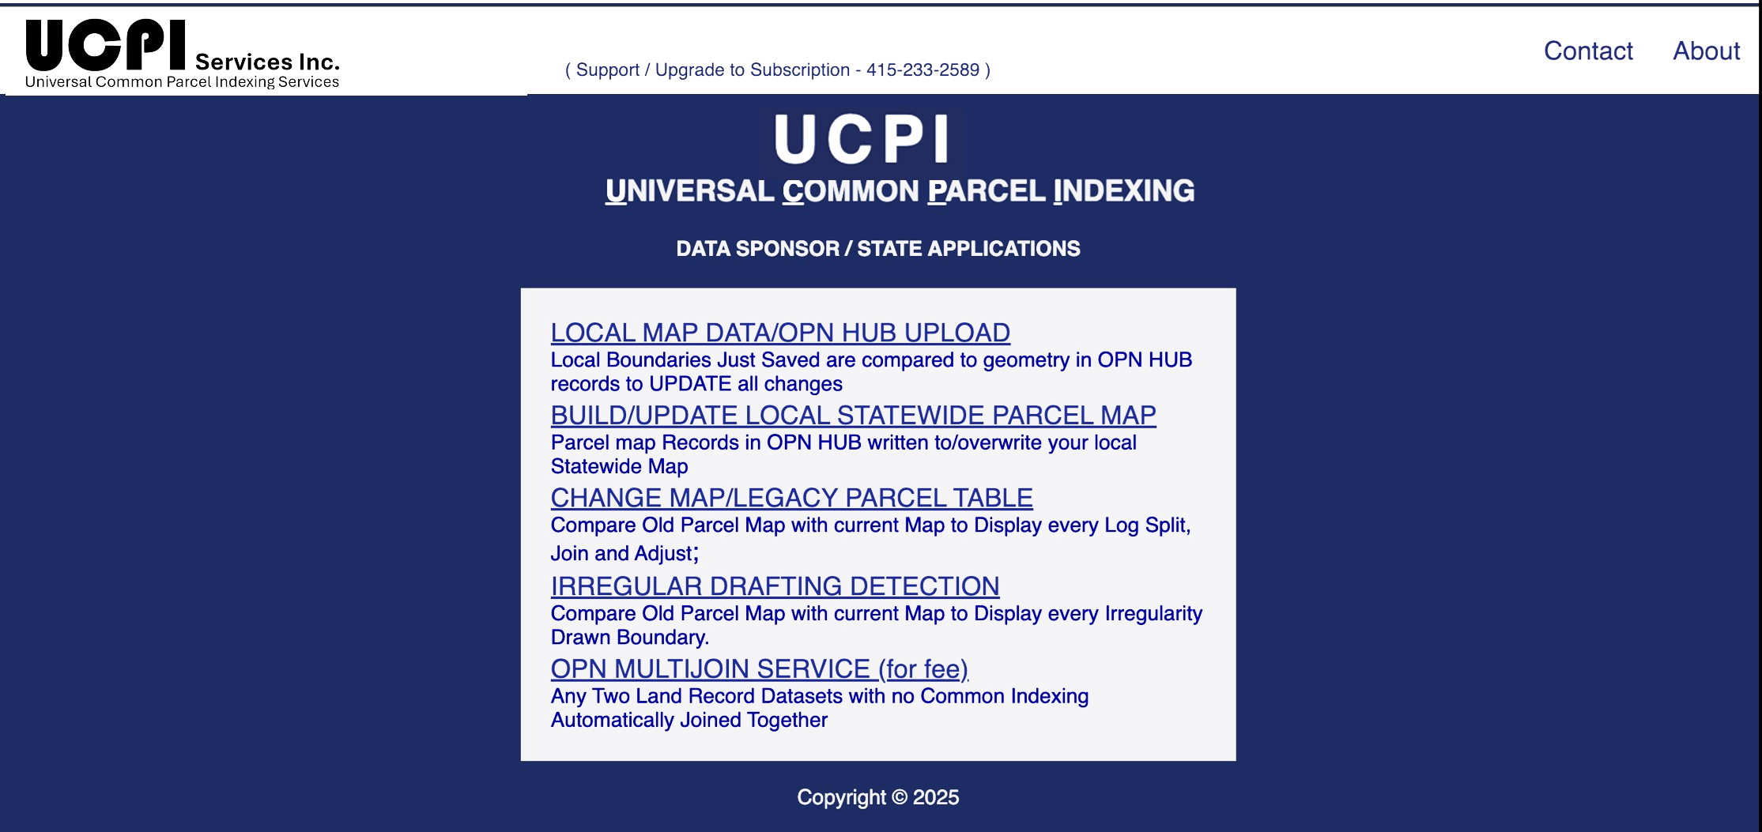


WHAT IT DOES
COUNTY/STATE
UPDATE
INTERFACE
State UCPI Subscriptions includes APIs provided to every legislated local data providers [LDS] enabling the latest local parcel map changes to update boundaries/ OPNs in the OPN HUB for world-wide reporting as they occur.

Slide 10
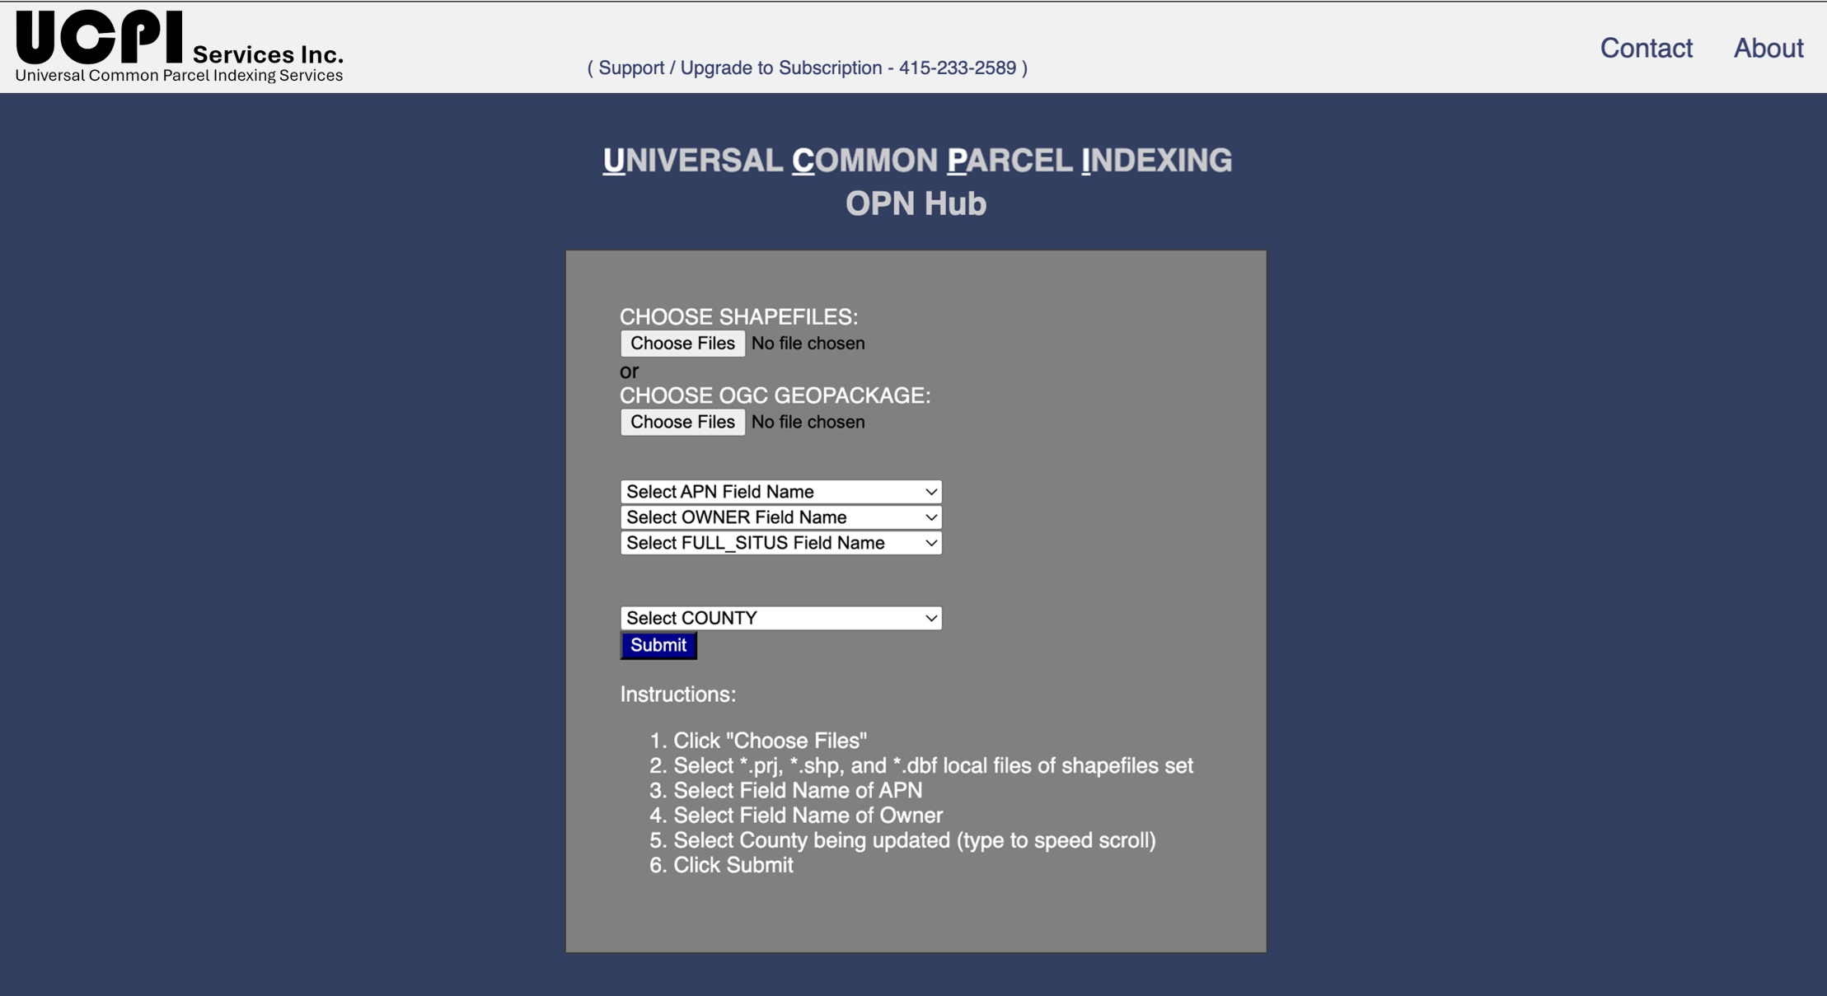
WHAT IT DOES
COUNTY/STATE
UPDATE
INTERFACE
UCPI User Interface
Everyone everywhere updating their national map the same way all over? IMPOSSIBLE! Possible.
Fill out this screen, make these selections and you are one.
Select File Name
Select APN Field
Select OWNER Field
Select PIP Fields
SUBMIT
From then on, every time the map is saved locally, OPN HUB is updated Nationally with NO CHANGE AT ALL TO LEGACY OPERATIONS.

Slide 11
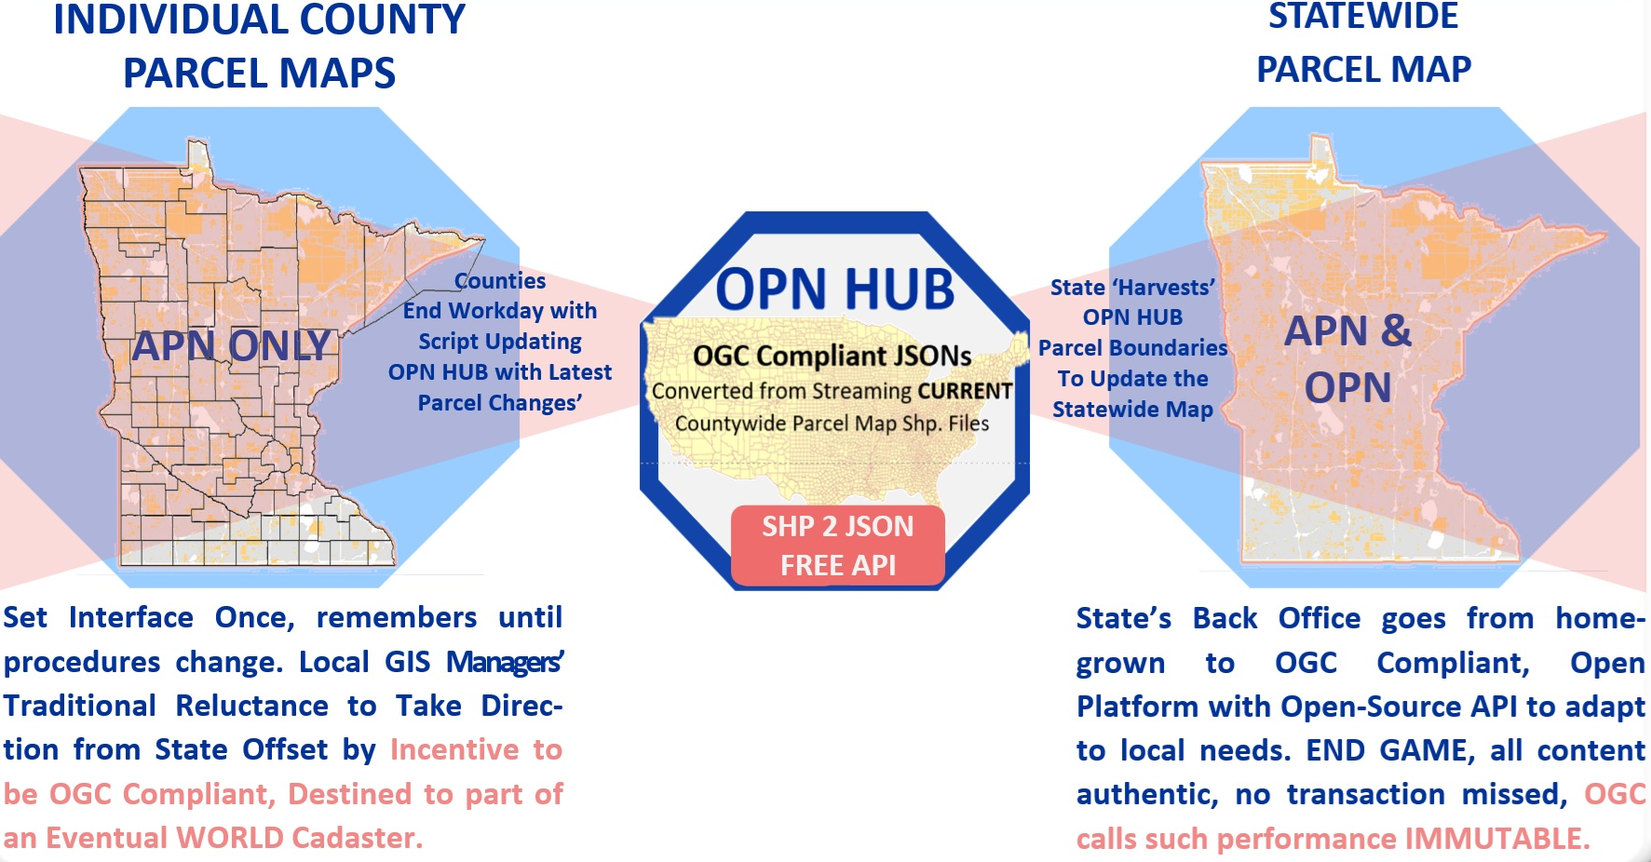
WHAT IT DOES
COUNTY/STATE
UPDATE
INTERFACE
Besides contributing to seamless real time updating of our national cadaster other benefits include:
Overcoming County GIS Manager traditional reluctance to support States with the extra incentive of being direct contributors to the national/worldwide cadaster.
State’s Backoffice goes from being a one-off proprietary, career-hampering-risk-of-it-going-off-the tracks, to a world standard remedy supported by industrywide sponsors.

Slide 12
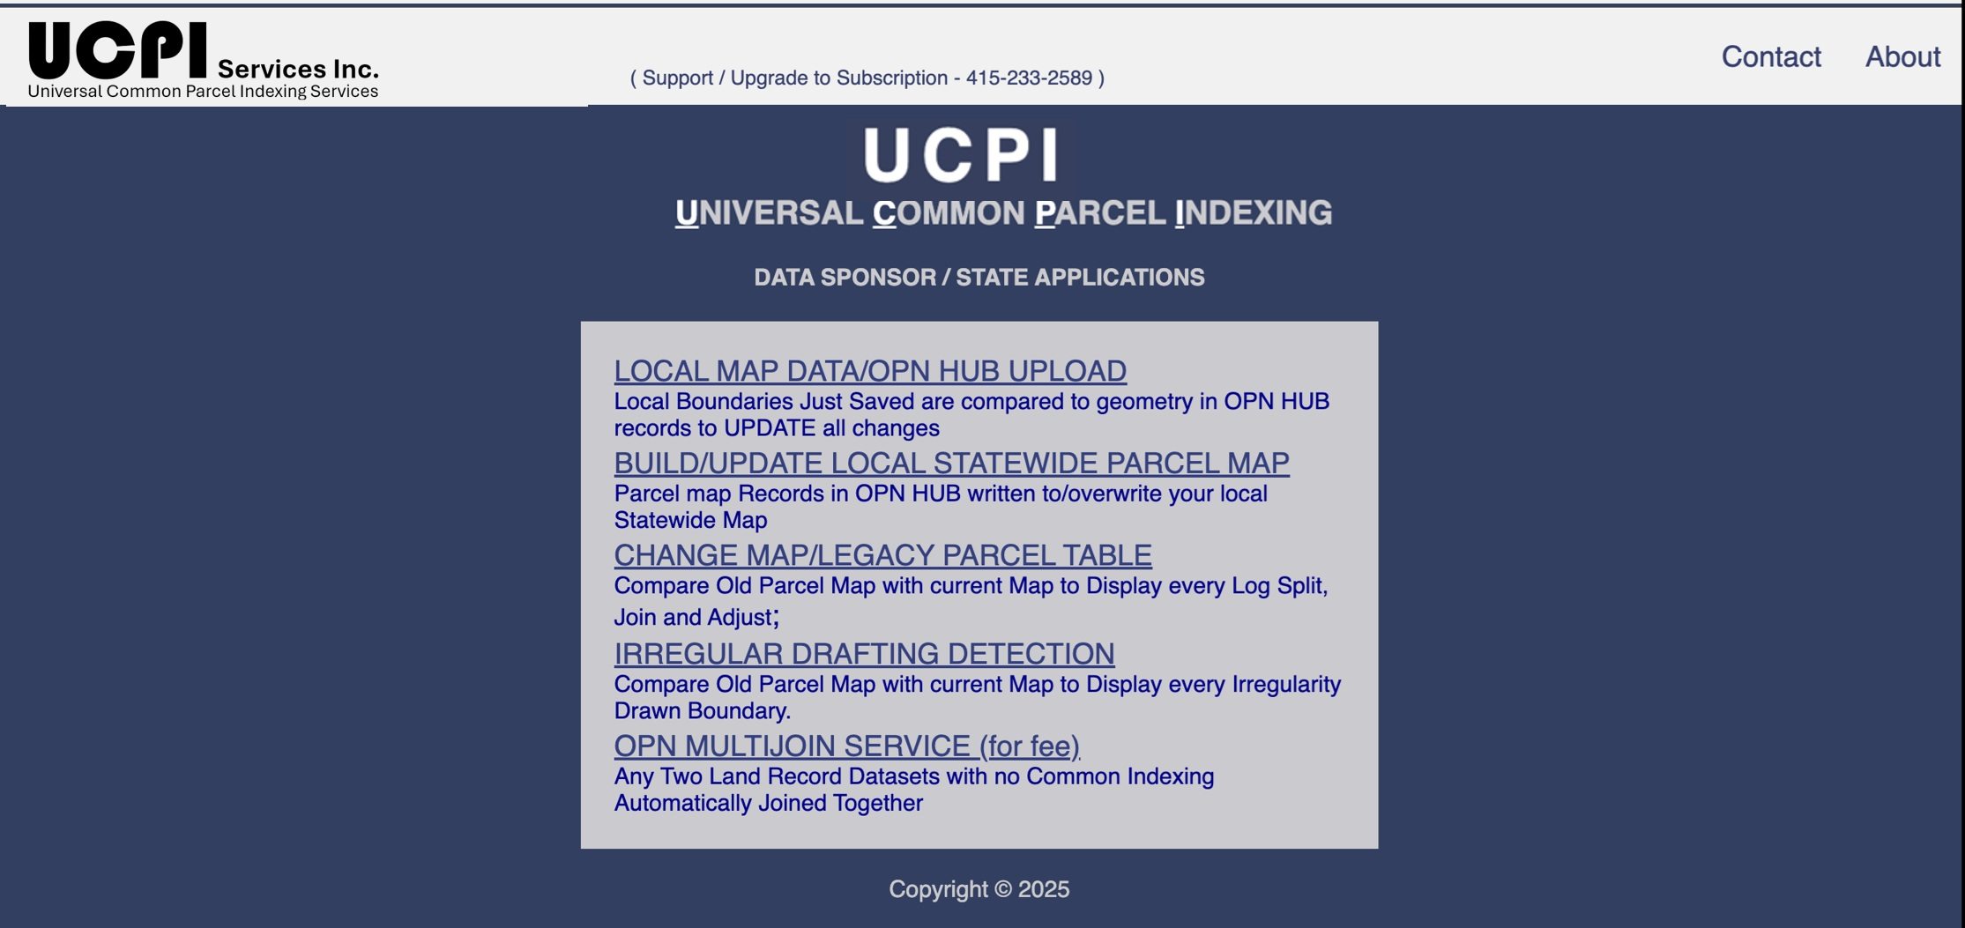
WHAT IT DOES
BUILD/UPDATE
STATEWIDE
PARCEL MAP
UCPI User Interface
As seen in the last slide, this API writes all county parcel map JSONS in the OPN HUB to a Statewide parcel map to a one-time selected native format, keeping it current.

Slide 13
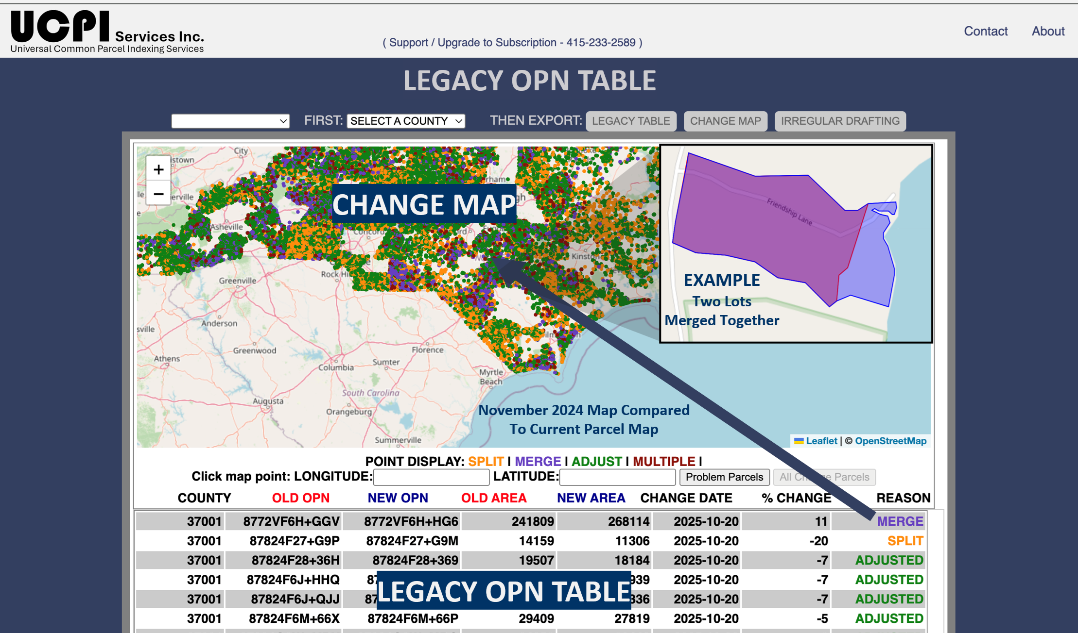
WHAT IT DOES
CHANGE MAP
& LEGACY OPN
TABLE
UCPI User Interface
How was this map made?
1. All the latest county parcel maps in the State are already replicated as a JSON in the OPN HUB.
2. Upon older maps being loaded, all the latest [CURRENT] OPNs are compared to the prior OPNs. All polygons assigned OPNs with no Old/New OPN match are displayed.
3. Records defining the type, date and past/present owner of each change are written to a LEGACY OPN TABLE for vastly expanded analytics.

Slide 14
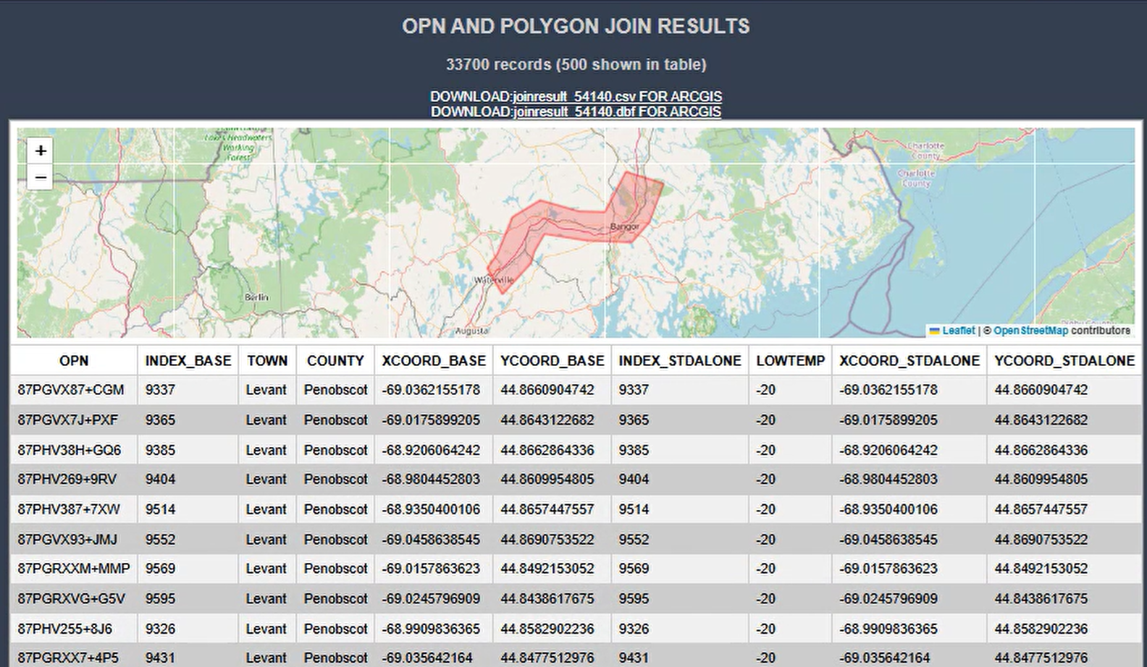
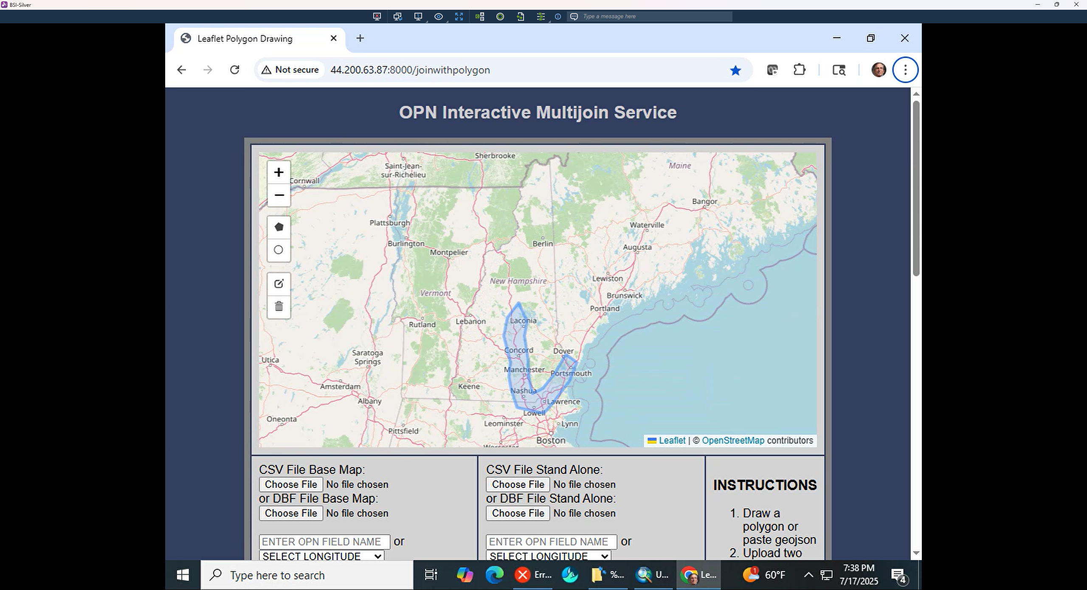
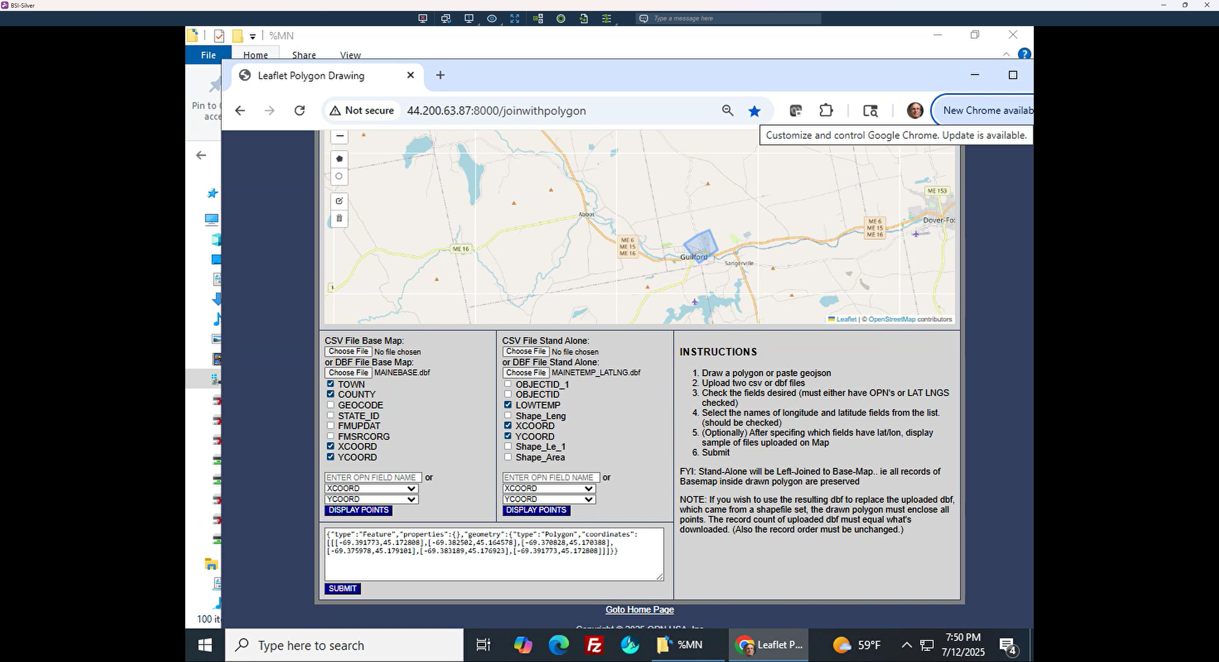
WHAT IT DOES
TABLE JOIN -
DATA SILO
ENDER [for fee]
UCPI User Interface
Have two Land Record Files with no common indexing?
Would your State/County benefit from them being combined into a single file?
Select Names, Key Fields, Lat/Long Point-in-Polygon Fields of each file. DONE!
UCPI sends PIPs of each record in both files to HUB, returns and assigns OPNs to each, followed by an OPN2OPN join, whole state or selected area.

Slide 15
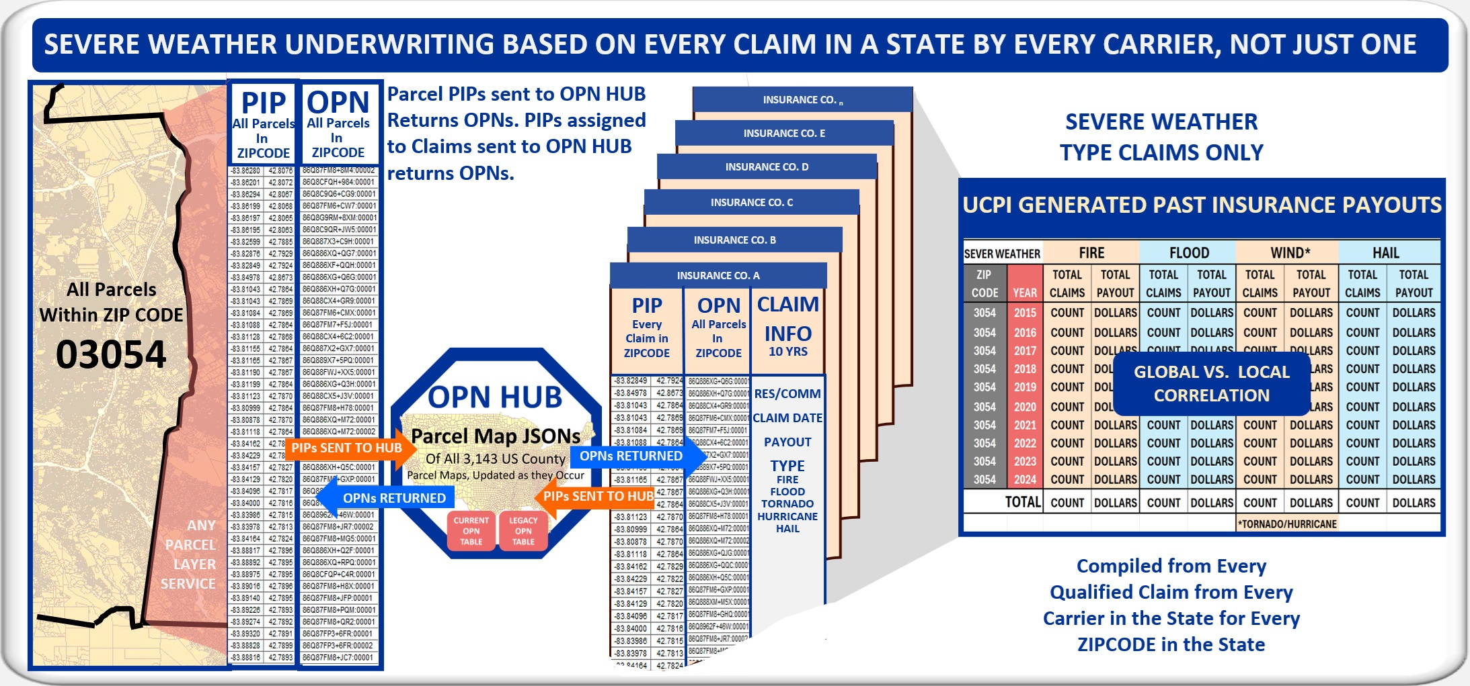
WHAT IT DOES
BROAD DATA
COMPILATION
UCPI User Interface
EXAMPLE
Expanding Severe Claims Under-writing from individual carriers to every claim of every carrier in a State. Carrier 1 sends LAT/LONG Point in Parcel assigned to every claim to the OPN HUB, each returning and assigning OPNs to the record. Ditto Carrier 2, 3, …n. Upon OPNs assigned to all claims of all carrier, scripted OPN2OPN Joins reports by ZIP Code, Claim Type, Date and Payout. This first-time historic record compilations are starting to be used to validate the many evolving sever weather forecasting algorithms.

Slide 16
TERMS
UCPI STATE SUBSCRIPTION TERMS
UCPI SERVICES OBLIGATIONS
Provided Free for Pilot Subscribers, subsequent for-fee Schedule by Transaction [PIP To HUB Returning OPN]:
All UCPI APIs including Local Data Sponsor [LDS]/State Update Interface, Statewide Map Update, CHANGE MAP and LEGACY OPN TABLE.
Best Efforts to enable all Local Data Sponsors to initialize their UCPI API.
Unlimited Support for UCPI Application Consultation.
Support PR leveraging one-time/real-time property change reporting to lure investment from Wall Street to down the street.
Provide Laisan between State/LDS and Open Geospatial Consortium for collaboration with worldwide UCPI / OPN SWG efforts.
Leverage early successes to eventual transformation to a Geospatial Foundation Service.

Slide 17
TERMS
UCPI STATE SUBSCRIPTION TERMS
STATE SUBSCRIBER OBLIGATIONS
Shall provide best effort to:
- Distribute Local/State Interface APIs to all LSPs and aid in its installation.
- Use State Update API to publish statewide parcel map in preferred format.
- Encourage real time updating of the OPN HBU by all LSPs.
- Take credit at next year’s budget hearing for the bump in State Tax Base Growth due to increased real estate data timeliness.

Slide 18
UCPI Services, Inc.
Universal Common Parcel Indexing
UCPI STATE SUBSCRIPTION BENEFIT rECAP
Statewide Parcel Database Updates same time, one time, as local lot line changes happen.
Statewide Parcel Map Republishing Automatically Upon Posting of Local Changes.
CHANGE MAP Highlighting Every Lot Split, Join and Adjustment since a User Specified Time.
- LEGACY OPN TABLE Archiving Every Lot Change by Type, Date, and Owner for Expanded Change Monitoring Analytics.
Silo Elimination. Record Sets with no Common Indexing Joined together Statewide or Selected Areas.
Broad Compilation, i.e., Every Insurance Claim of every Carrier in the State by:
Zip Code, Severe Weather Type, Date and Payout Amount compiled in less than 1 Hour, not month.
Potentially Free Service to all Sectors funded by Geospatial Foundations in return for enhanced Information Infrastructure Quality
Increasing For-Profit Revenues.

Slide 19
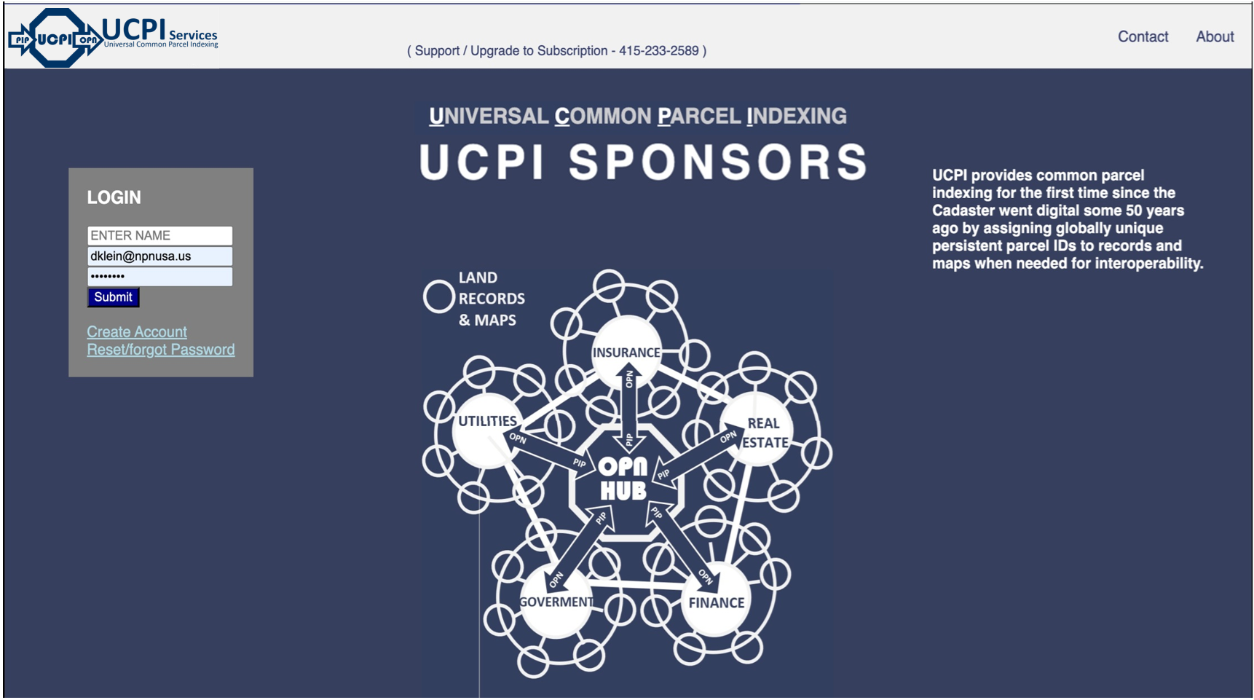
UCPI Services, Inc.
Universal Common Parcel Indexing
next step
CLICK HERE
to go to this Screen
Start Using UCPI, Tutorial and Subscription Terms Above.

