Slide 1

UCPI for State Insurance Commissioners
Comparing Severe Weather Prediction to Real Outcome
OPN [Open Parcel Number] Assignment for First Time Easy, Instant Broad Data Amalgamation.

Slide 2
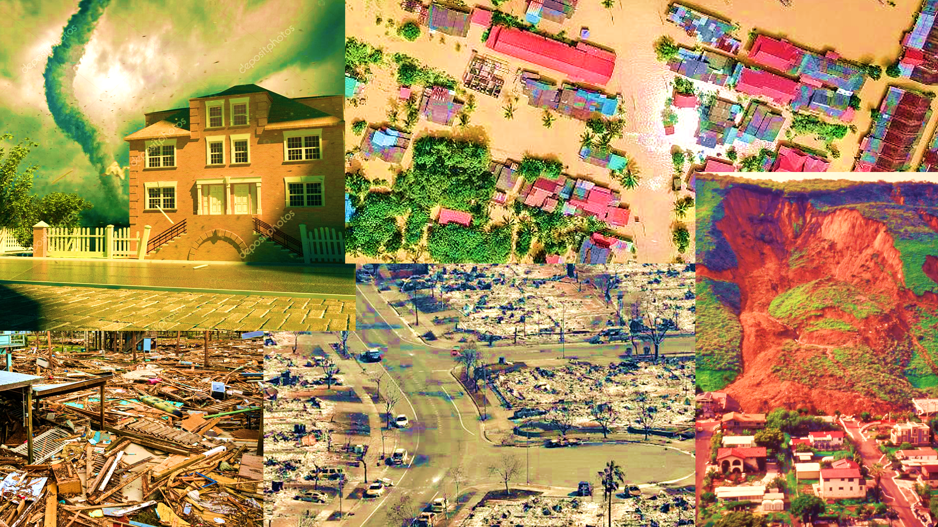
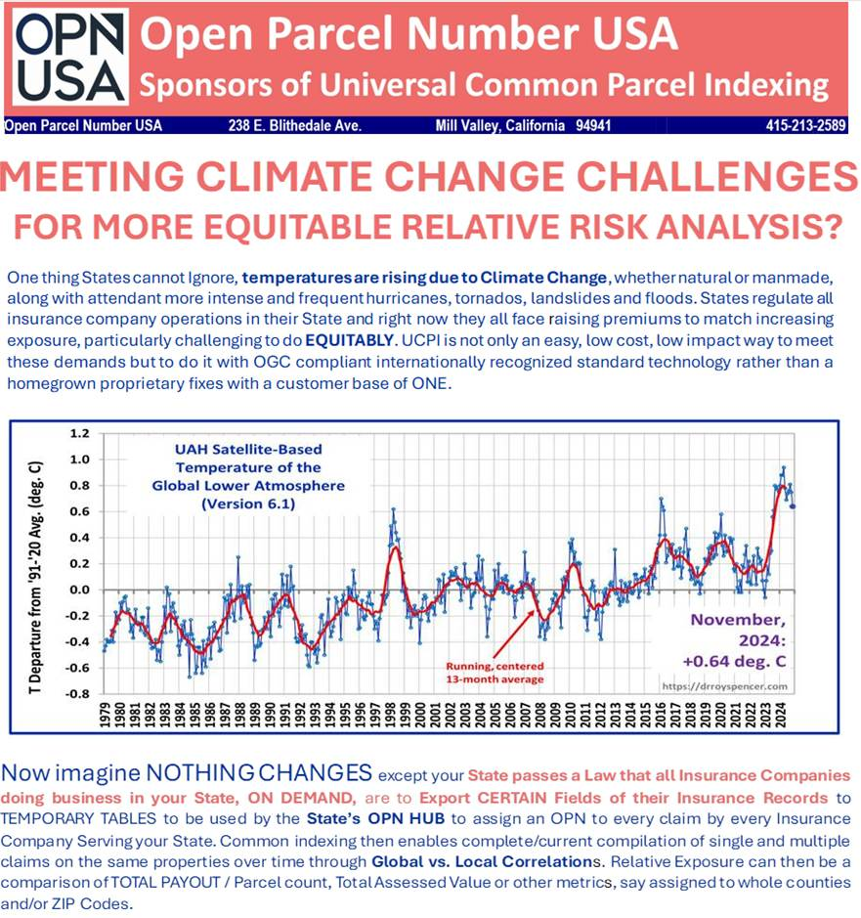
SITUATION
Severe Weather Claim Payouts Up 3X Last 10 Years
HIGHER INTENSITY AND GREATER FREQENCY OF FIRES, FLOODS,
HURRICANES, TORNADOS AND LANDSLIDE EVENTS ON THE RISE.

Slide 3
SITUATION
Severe Weather Claim Payouts Up 3X Last 10 Years
What can States Do to Lighten the
Impact on Carriers and Constituents?

Slide 4
APPROACH
Connecting Weather Forecasts to Real Losses
Severe weather forecasts keep getting better. With UCPI (Universal Common Parcel Indexing), PREDICTED storm damage can be EASILY compared to the HISTORIC storm damage (insurance payouts) over time for specific areas. How? On-the-fly, every property and every claim by every carrier in a State is assigned an OPN [Open Parcel Number] a nonproprietary globally unique ID. Scripted joins follow.
What’s Needed to Do this at State Scale:
Data request: Hard part, State Insurance Commissioners asking all carriers to submit extracted claim record fields:
Type, Payout Amount, Date, and latitude/longitude Pt-in-Property. [PIP]
Authority Exists: An OPN USA, Inc. survey of 40+ states indicates data can be requested, ~5 with Assembly approval.
Best path: State contracts with certified Reinsurer partner that embeds UCPI into their workflows.
Result: Easy part. Low-cost, statewide real property underwriting based on the complete parcel-level claim history across all claims of all carriers, not just one company’s records.

Slide 5
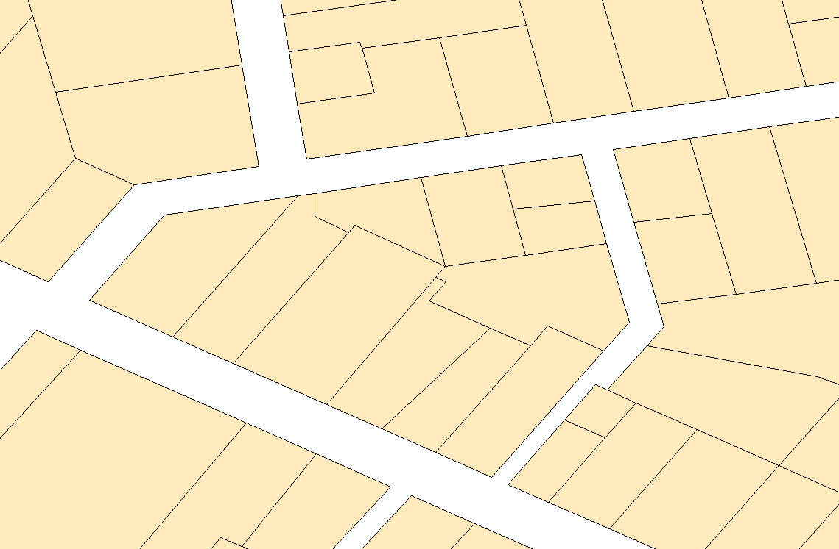

PROBLEM
No Common Indexing
HARD TO LINK RECORDS TO MAP
- Currently over 4000 US legislated Local Data Sponsors [LDS] assign Assessor Parcel Numbers to properties, each using unique formats and methods. No standardization. No common indexing.
Most developed nations, past kingdoms or colonies, have a form of UCPI, national registry their culture. Change anywhere is reported everywhere in their nation. In the US, in exchange for the benefit of assessments being a more easily challenged local affair, a change anywhere is oft not reported even across the County line.
Currently common indexing is proprietary to each commercial provider. The reporting of parcel lot splits, joins and adjustments is when a commercial company reports it, resulting in it being known at up to dozen different times according to service provider.
?
?
?
?
?
Nongraphic
Record
No Common Indexing
HARD TO COMBINE DATABASES
Data HUB No NPNs
Cannot Be Joined
PROPRIETARY Index₁ Attributes₁
PROPRIETARY Index₂ Attributes₂
PROPRIETARY Index₃ Attributes₃
PROPRIETARY Index₄ Attributes₄
APN₁ Attributes₁ OPN₁
APN₂ Attributes₂ OPN₂
APN₃ Attributes₃ OPN₃
APN₄ Attributes₄ OPN₄
NO JOIN
No Common Indexing

Slide 6
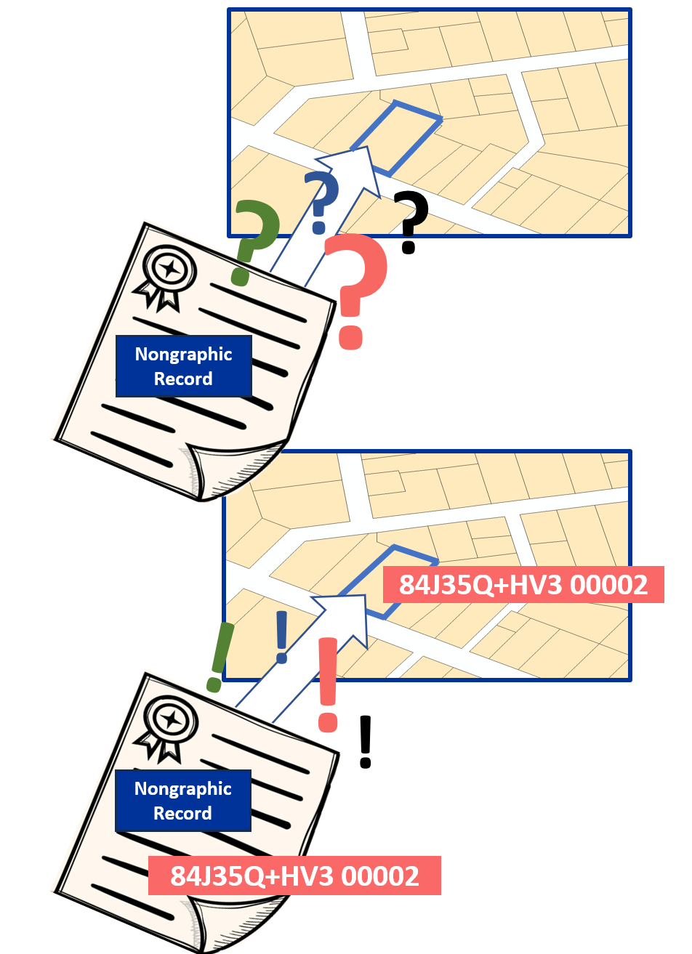
REMEDY
Persistent, Nonproprietary
Open Parcel Numbers
RECORDS EASILY LINKED TO MAP
- Open Parcel Numbers is subject of OGC OPN Standard Working Group, Member Comment Period Feb 3 – 23.
- UCPI Assigns OPNs to both Parcel Polygons and Records
The UCPI functions as an Open Platform Service, available to ALL users at the same time with industry participation minimizing cost.
Potential transformation into a Geospatial Foundation to expedite optimized industry efficacy.
Particularly Improved Currency and Interoperability.
!
!
PLUS CODE
PID [Property Record ID]
!
!
Nongraphic
Record
EASILY COMBINED DATABASES
HUB w. NPNs
Database Easily Joined with Hub
Attributes₁ OPN₁
Attributes₂ OPN₂
Attributes₃ OPN₃
Attributes₄ OPN₄
OPN₁ Attributes₁
OPN₂ Attributes₁
OPN₃ Attributes₁
PN₄ Attributes₁
APN₁ Attributes₁
APN₂ Attributes₂
APN₃ Attributes₃
APN₄ Attributes₄
Point-and- Shoot
JOIN

Slide 7
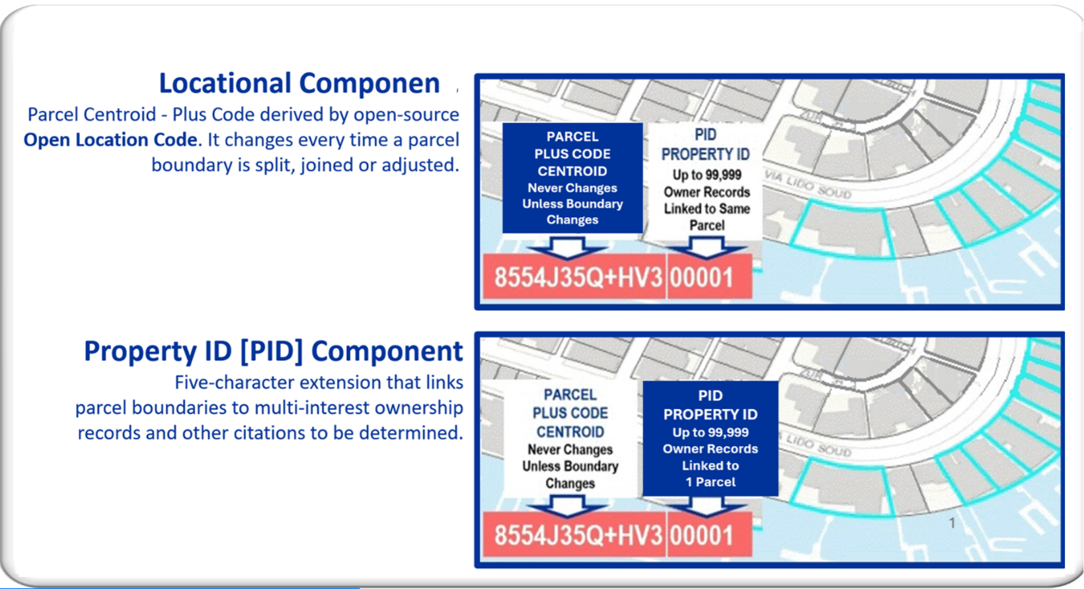
HOW IT WORKS
OPN
ARCHETECTURE
t

Slide 8
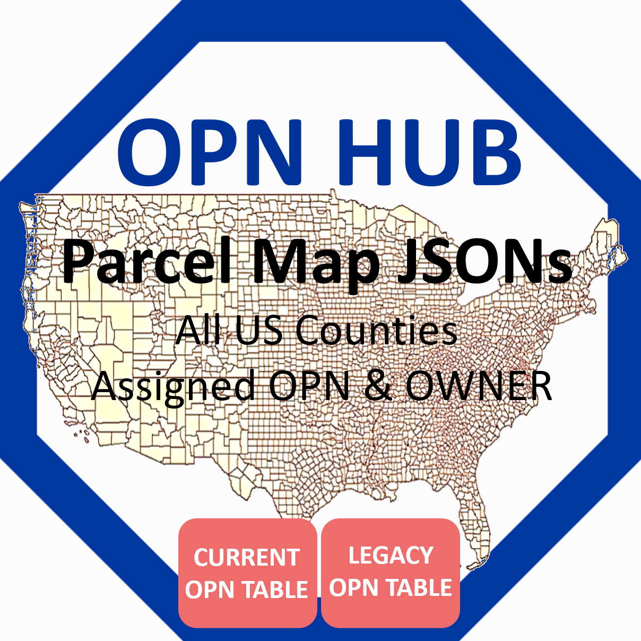
HOW IT WORKS
UCPI
KEY ELEMENT
OPN HUB is a compilation of JSONs of Every USA Parcel supported by LEGACY OPN TABLE for Change Monitoring.
Source Files PIP [lat-long in Parcel] sent to OPN HUB finds JSON Boundary RETURNS & Assigns OPN to Source.
OPNs Assigned only
WHEN-NEEDED ON-THE-FLY
Open Parcel Number [OPN] Fields include OPN, APN, OWNER CHANGE DATE.

Slide 9
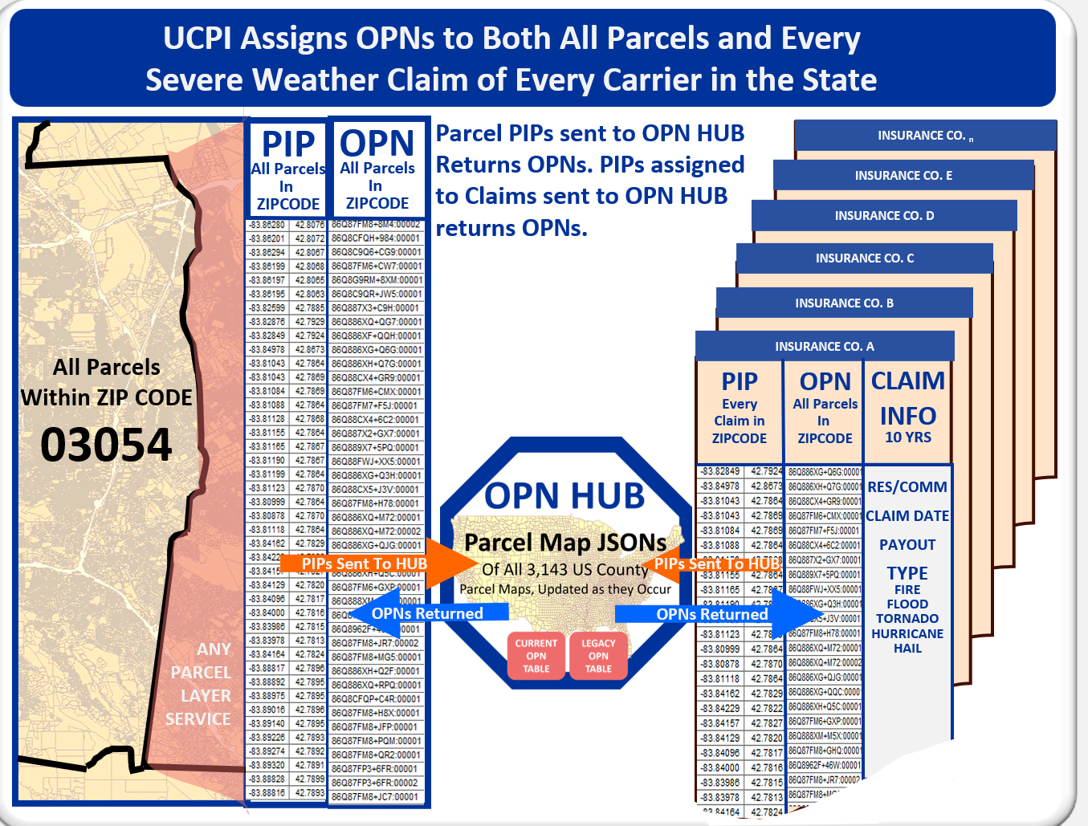
HISTORIC CLAIMS COMPILATION
OPN
ASSIGNMENTS
Carrier 1 sends LAT/LONG Point in Parcel Assigned to every pertinent claim to the OPN HUB. Each finds among the JSONs the corresponding parcel polygon and adds its assigned OPN to the record.
Ditto Carrier 2, 3, …n. An OPN2OPN Join follows upon assigning an OPN to every parcel boundary in the State to assure correct ZIP CODE assignment.
Notes:
No integration with ANY system is required, OPN’s are assigned to each data table being utilized and sent back to the user to conduct their work

Slide 10
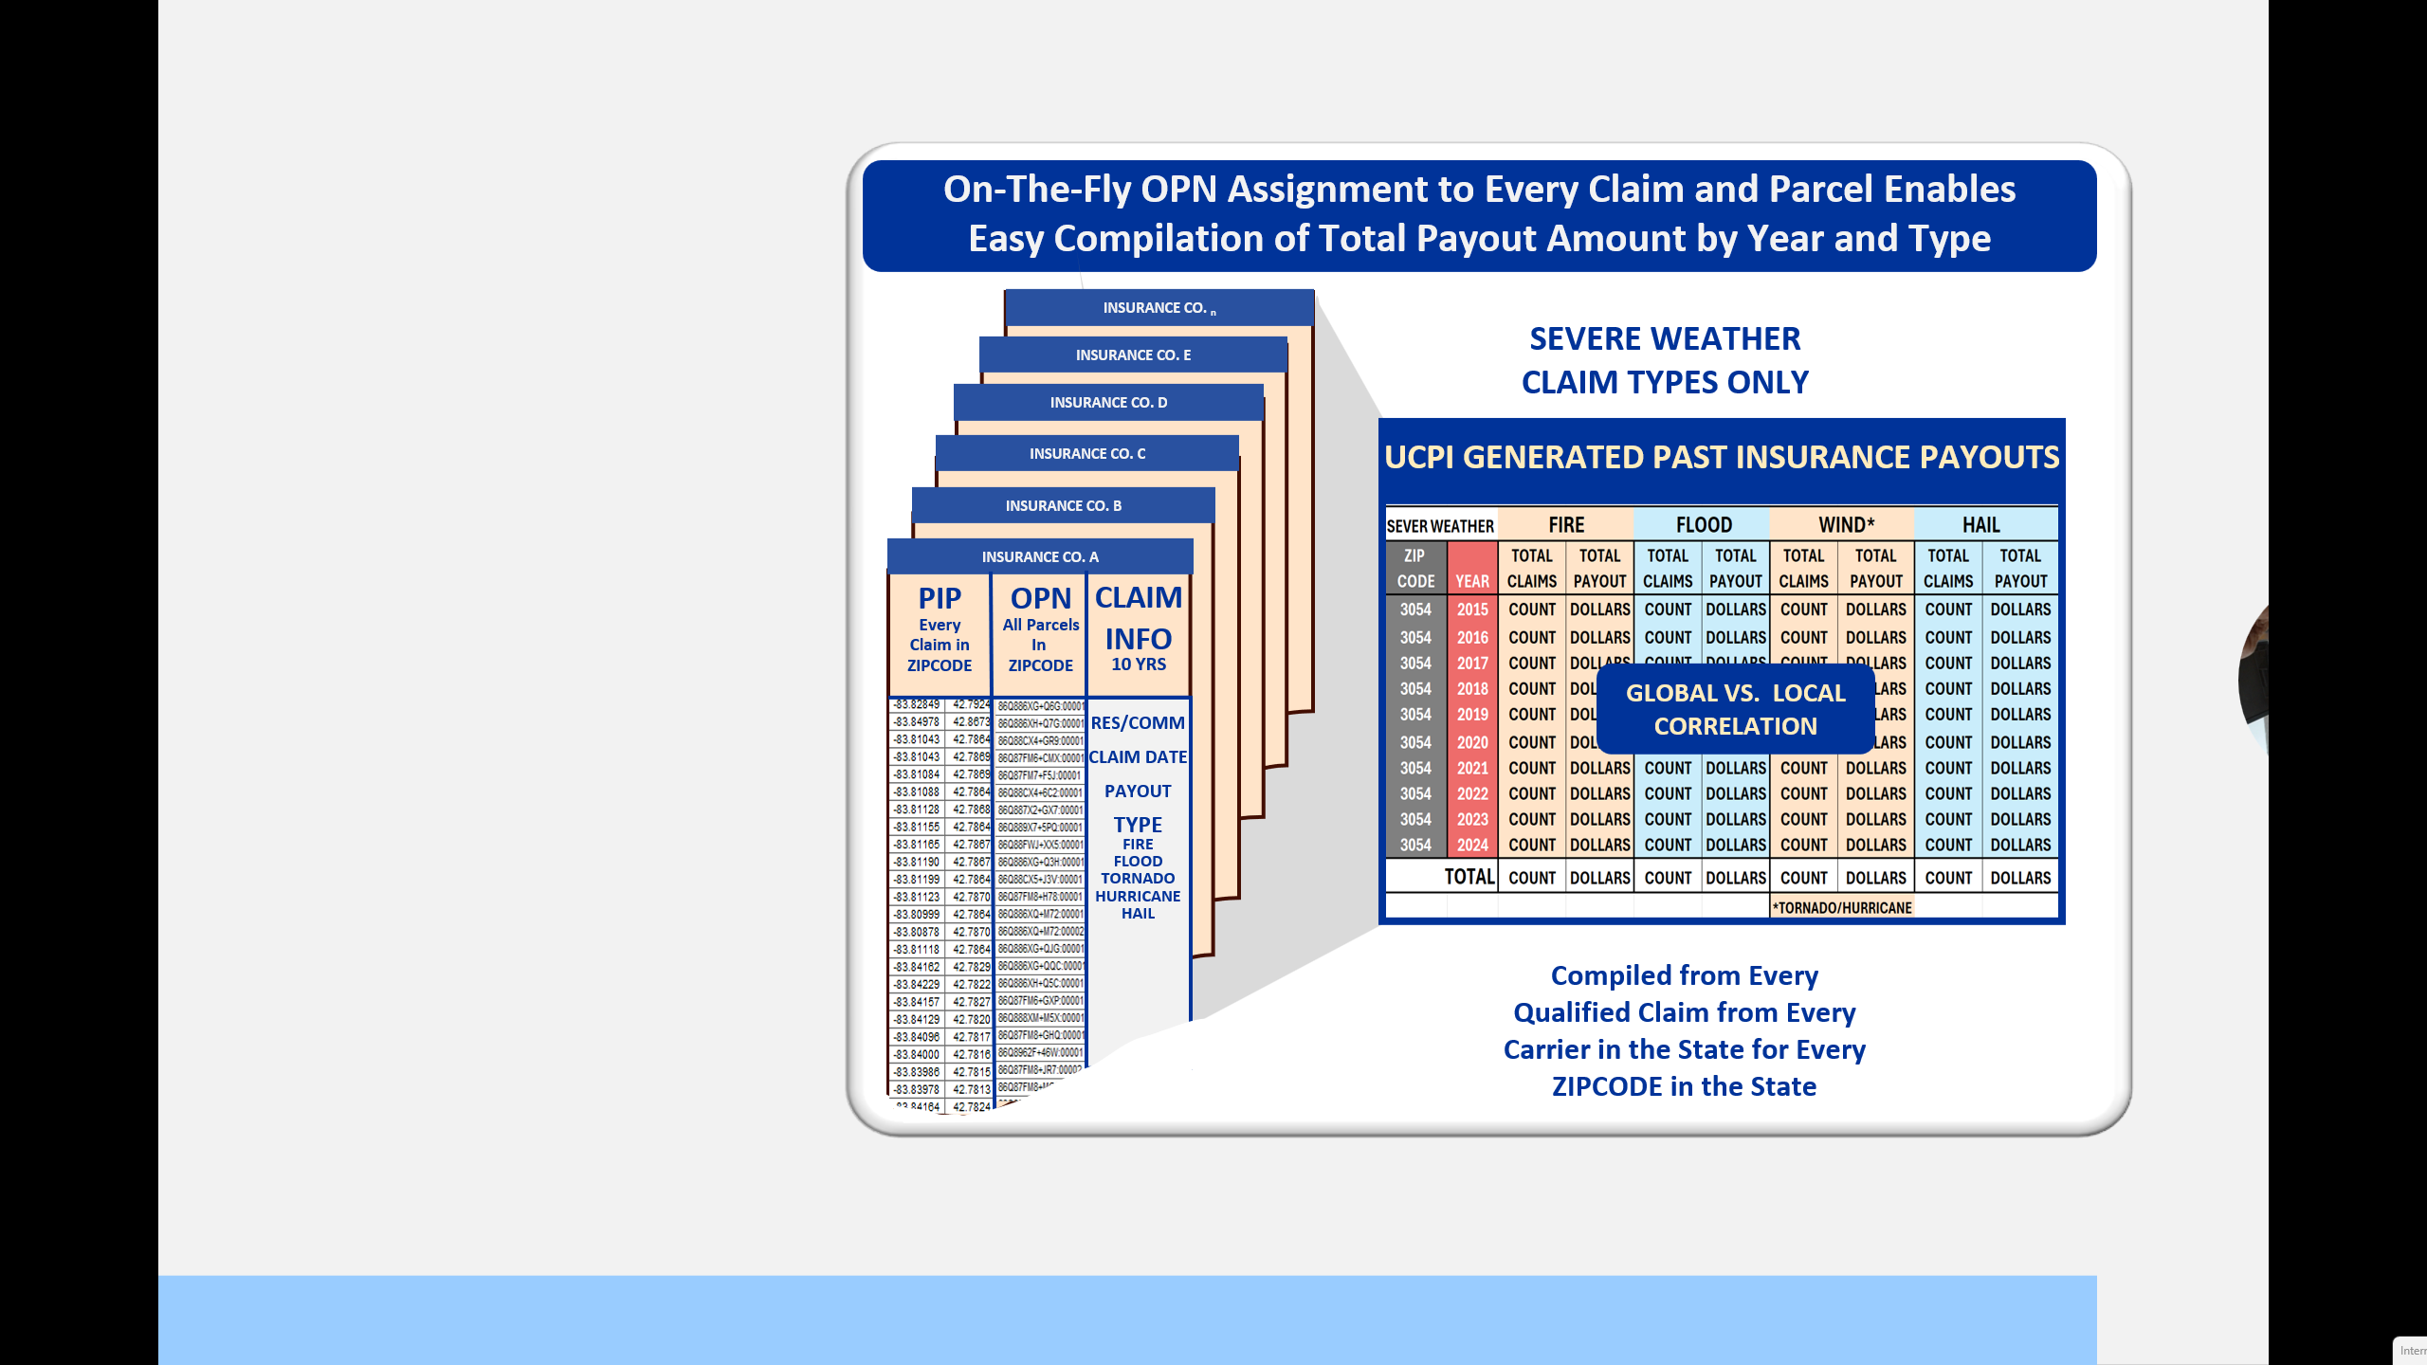
HISTORIC CLAIMS COMPILATION
STATEWIDE
CLAIMS
COMPILATION
With an OPN assigned to every claim record, along with a verified ZIP CODE, Extreme Weather Underwriting is expanded for each individual Carrier to compilation by ZIPCODE of the Total Claim Payout Per Year, by Type incurred by ALL Carriers in the State..

Slide 11
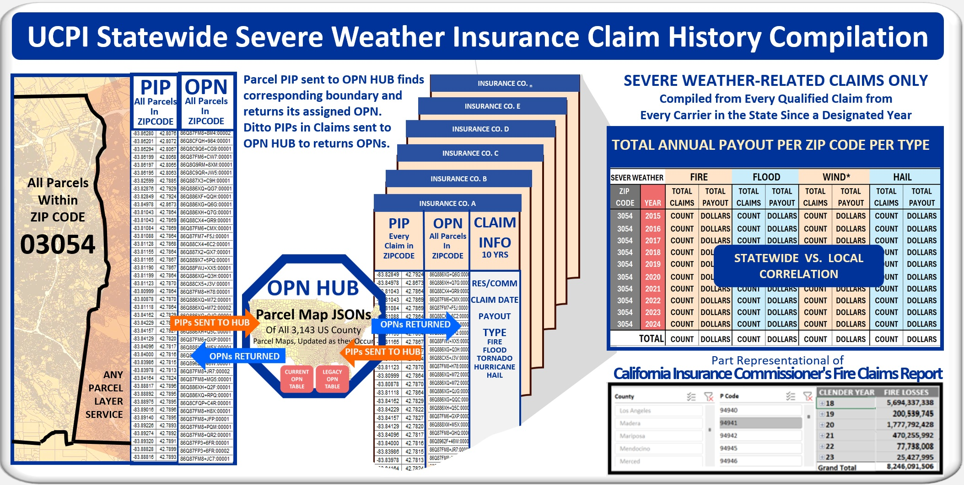
HISTORIC CLAIMS COMPILATION

Slide 12
CONCLUSION
Basis for Severe Weather Insurance Underwriting review expanded
from one Carrier’s Claim history to that of all Carriers in the State.
NO IMPACT on Legacy Operations – OPN HUB Outside Enterprise.
Severe Weather Analytics can for the first-time Compare
PREDICTED Severe Weather Effect with HISTORIC Effect [Payout Trends].
State to Encourage all Severe Weather Prediction and Forecasting
Services to Build UCPI’s Validating Capacity into their algorithms.
Expand Underwriting
To all Claims
All Carriers

Slide 13
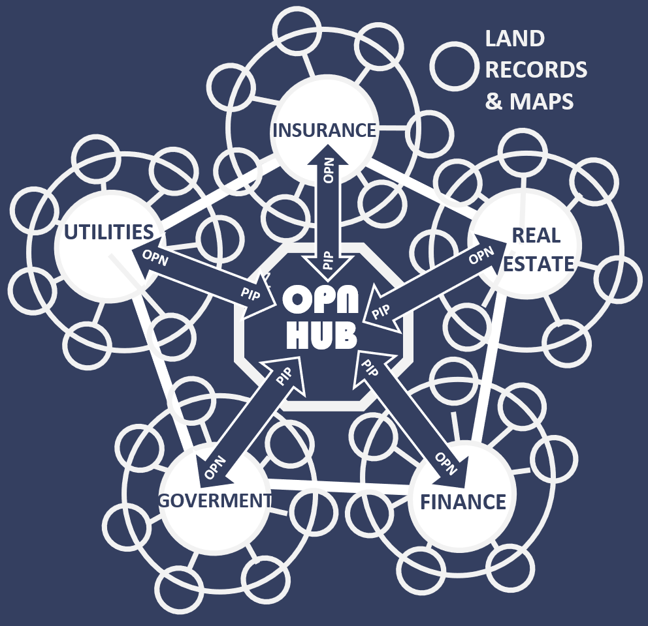
UCPI
Applications
Beyond
Insurance

